Slide 1

Bangla Text Categorization using Machine Learning
Cse400_191_A1
Course teacher: Assoc. Prof. Dr. Dewan Md. Farid
Supervisor: Prof. Dr. Mohammad Nurul huda
Group Members:
Nusrat Jahan Jenny ID:011151019
Anika Ibnat Binte Alam ID:011151027
Muzahidul Islam ID:011151070
Md Rabi-Ul Alam Chowdhury ID:011151066
Bangla Text Categorization using ML
Dept. of CSE, UIU

Slide 2
Overview
Text Categorization
Applications & Use Cases
Text categorization using Machine Learning
Problem Statement
Motivation
Existing Work
Comparison
Birds eye view
Steps
Classification model and accuracy
Screenshots
Impacts and constraints
Standards
Bangla Text Categorization using ML
Dept. of CSE, UIU

Slide 3
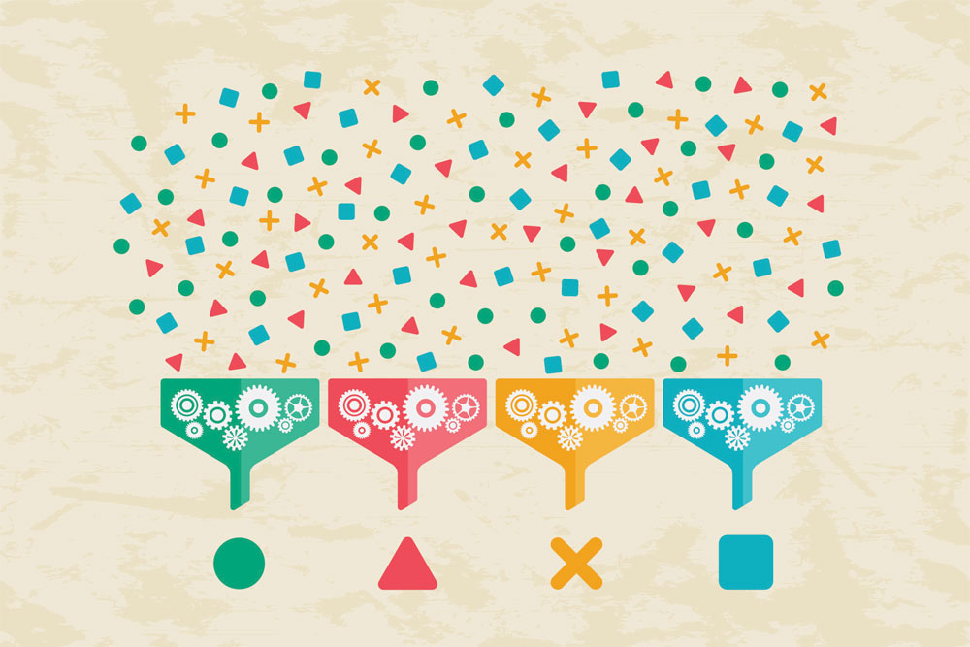
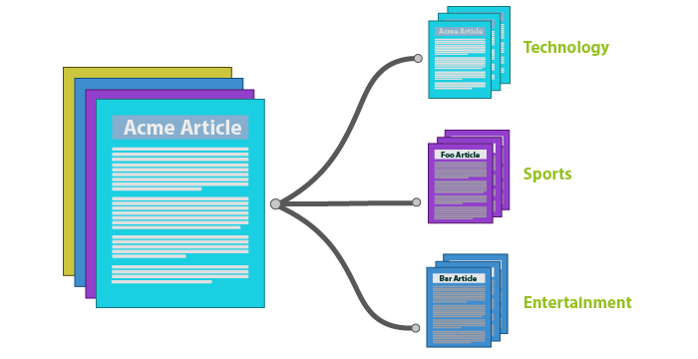
Text Categorization
Digital Content
Activity of labeling natural language texts with relevant categories from a predefined set
Bangla Text Categorization using ML
Dept. of CSE, UIU

Slide 4




Applications & Use Cases
Tagging content to improve Browsing Website
CRM tasks : Product reviews, surveys
SEO : better experience in Web crawling
Sentiment analysis : better responsive system
Marketing management
Different organizational needs to structure unstructured data
uClassify
Bangla Text Categorization using ML
Dept. of CSE, UIU

Slide 5
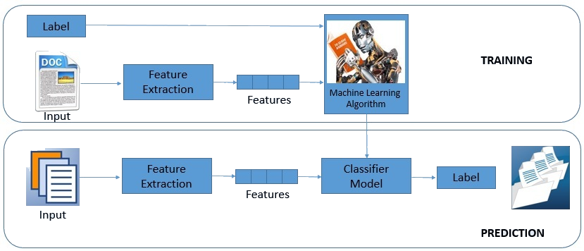
Text Categorization using Machine Learning
Bangla Text Categorization using ML
Dept. of CSE, UIU

Slide 6

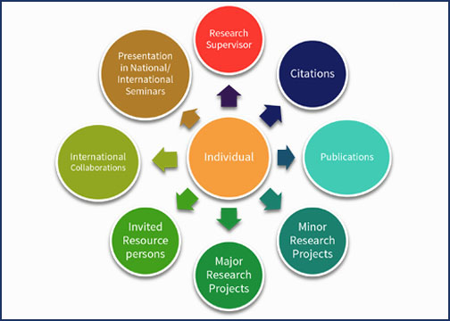
Problem statement
Scattered Content
Research Work
Bangla Text Categorization using ML
Dept. of CSE, UIU

Slide 7


Motivation
Ranked 7th worldwide
Organization & retrieval
Improvement of
search engine
Bangla Text Categorization using ML
Dept. of CSE, UIU

Slide 8
Existing Work
Dhar, A., Dash, N.S. and Roy, K., 2018, January. Categorization of Bangla Web Text Documents Based on TF-IDF-ICF Text Analysis Scheme. In Annual Convention of the Computer Society of India (pp. 477-484). Springer, Singapore.
Al Mostakim, S., Ehsan, F., Hasan, S.M., Islam, S. and Shatabda, S., 2018, September. Bangla Content Categorization Using Text Based Supervised Learning Methods. In 2018 International Conference on Bangla Speech and Language Processing (ICBSLP) (pp. 1-6). IEEE Explore.
Alam, M.T. and Islam, M.M., 2018, September. BARD: Bangla Article Classification Using a New Comprehensive Dataset. In 2018 International Conference on Bangla Speech and Language Processing (ICBSLP) (pp. 1-5). IEEE Explore.
Banik, N. and Rahman, M.H.H., 2018, September. Evaluation of Naïve Bayes and Support Vector Machines on Bangla Textual Movie Reviews. In 2018 International Conference on Bangla Speech and Language Processing (ICBSLP) (pp. 1-6). IEEE Explore.
Bangla Text Categorization using ML
Dept. of CSE, UIU
8

Slide 9
Comparison
Features | Categorization of Bangla Web Text Documents | (BARD) | Bangla Content Categorization (UIU) | Bangla Textual Movie Reviews | Bangla Text Categorization using Machine Learning
Dataset | Online Bangla daily newspaper, webpages, magazines (4000) | Online Bangla news articles (376226) | Prothom-alo and Bdnews24(online) 51324 | Movie related Facebook groups, pages, twitter posts of famous reviewers and Bangla Movie Database (BMDb) ( No info) | Bangla newspaper article (40000)
Dataset Balanced | Yes (500) | No info | Yes | No info | Yes (740)
Category/label | 8 | 5 | 5 | 2 | 12
Sampling instances | No info | No info | Ordered | No info | Randomly
Features | Categorization of Bangla Web Text Documents | BARD | Bangla Content Categorization (UIU) | Bangla Textual Movie Reviews | Bangla Text Categorization using Machine Learning
Tf-Idf | Yes | Yes | Yes | No | Yes
Tf-Idf-Icf | Yes | No | No | No | No
Word2vec | No | Yes | No | No | No
Unigram | No | No | No | Yes | No
Naïve Bayes | Yes | Yes | Yes | Yes | Yes
Multinomial Naïve Bayes | Yes | No | No | No | No
Features | Categorization of Bangla Web Text Documents | BARD | Bangla Content Categorization (UIU) | Bangla Textual Movie Reviews | Bangla Text Categorization using Machine Learning
SGD classifier | No | No | No | No | Yes
Multilayer perceptron (MLP) | Yes | No | No | No | Yes
Hyper parameter tuned | No | No | No | No | Yes
Web application | No | Yes | Yes | No | Yes
Features | Categorization of Bangla Web Text Documents | BARD | Bangla Content Categorization (UIU) | Bangla Textual Movie Reviews | Bangla Text Categorization using Machine Learning
Decision tree | No | No | No | No | Yes
K-Neighbor Nearest | Yes | No | Yes | No | Yes
Logistic Regression | No | Yes | Yes | No | Yes
Random Forest | No | Yes | Yes | No | Yes
SVM (linear kernel) | No | No | Yes | Yes | Yes
SVM (rbf kernel) | No | No | Yes | No | Yes
Bangla Text Categorization using ML
Dept. of CSE, UIU
9

Slide 10
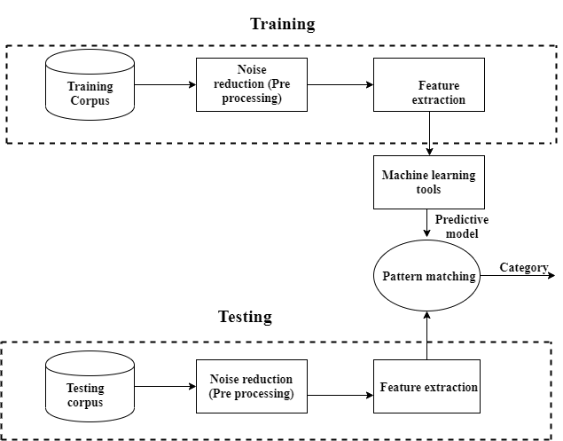
Bangla Text Categorization
Bangla Text Categorization using ML
Dept. of CSE, UIU

Slide 11
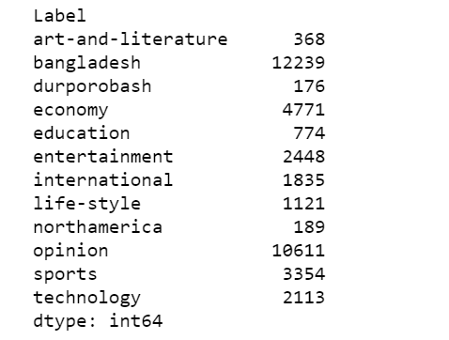
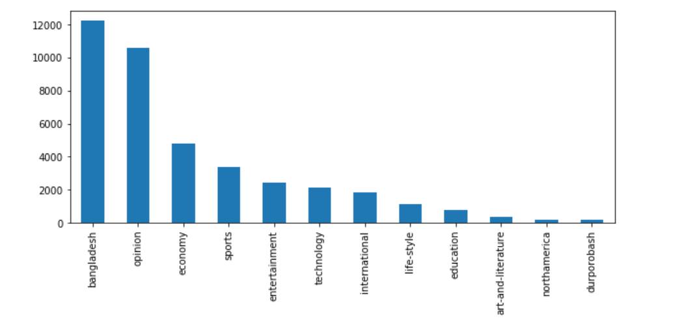
Steps:
Setting up the environment
Python
Loading the dataset
Dataset (40000) 12 categories
.p file .csv file
Preprocessing data
punctuations,
Bangla numeric numbers
duplicate and missing value instances
instances < 500
sampling instances > minimum 500 instances
Bangla Text Categorization using ML
Dept. of CSE, UIU

Slide 12
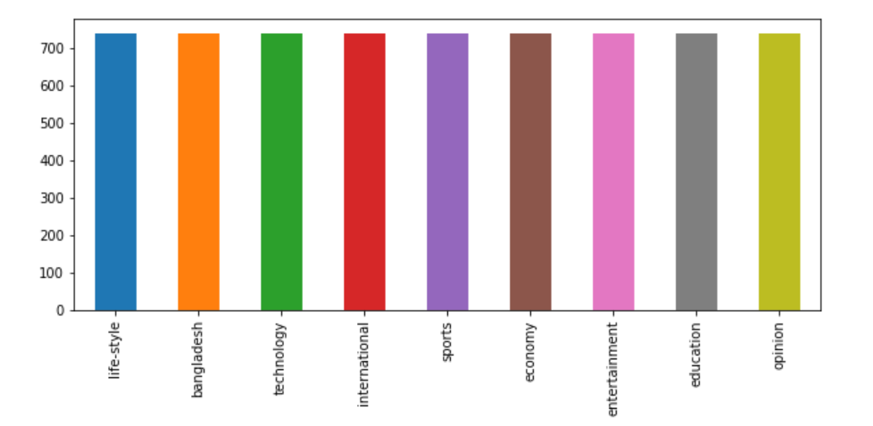
Final Features::
6660 final instances
54131 features
Bangla Text Categorization using ML

Slide 13
Selected Classifiers :
Linear model: SGD classifier, Logistic Regression
Ensemble model: Random Forest Classifier
Naïve Bayes model: Multinomial NB
SVM model: Linear SVC, SVC
Tree model: Decision tree classifier
Neighbor model: K neighbors classifier
Neural Network model: MLP classifier
Hyper tuning: Grid search
Bangla Text Categorization using ML

Slide 14
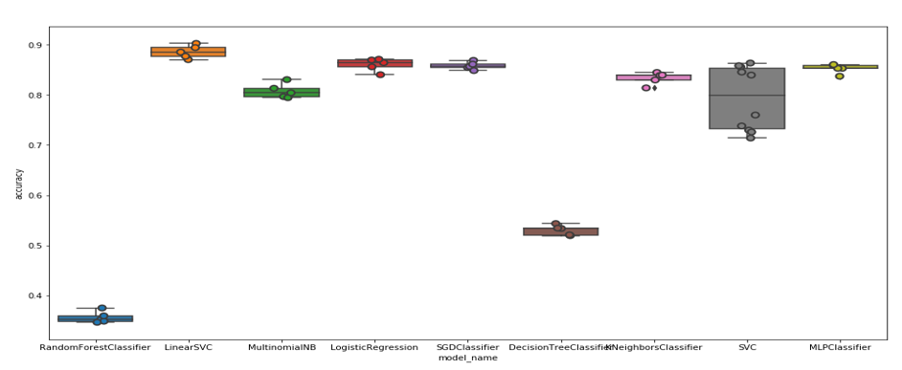
Steps:
Feature extraction
Tf-Idf
Bags of word
Model | Accuracy (mean) %
LinearSVC | 88.57
Logistic Regression | 86.00
SGD Classifier | 85.78
MLP Classifier | 85.20
K neighbors Classifier | 83.32
Multinomial NB | 80.77
SVC | 79.29
Decision Tree Classifier | 53.24
Random Forest Classifier | 35.66
Finding best classifier
Bangla Text Categorization using ML
Dept. of CSE, UIU

Slide 15
Classification model and accuracy:
6660 instances, 54131 features
Tf-Idf
Classifier: LinearSVC
Dataset
40000
Train:70%
Test:30%
Bangla Text Categorization using ML
Dept. of CSE, UIU

Slide 16
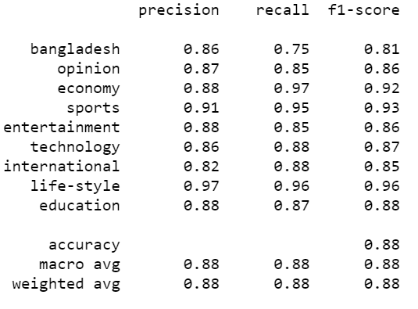
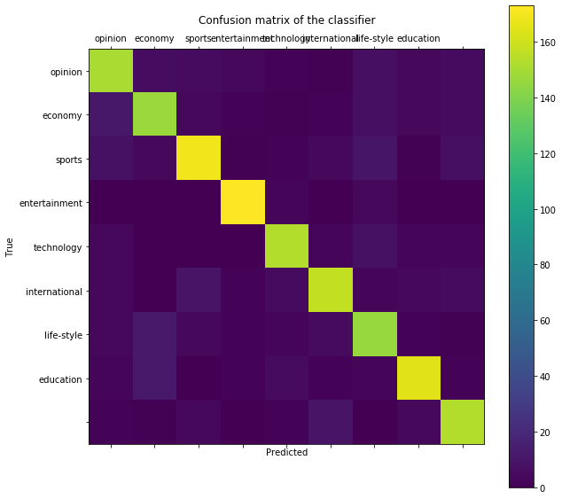
Classification model and accuracy:
Classification report
Confusion matrix
Bangla Text Categorization using ML
Dept. of CSE, UIU

Slide 17
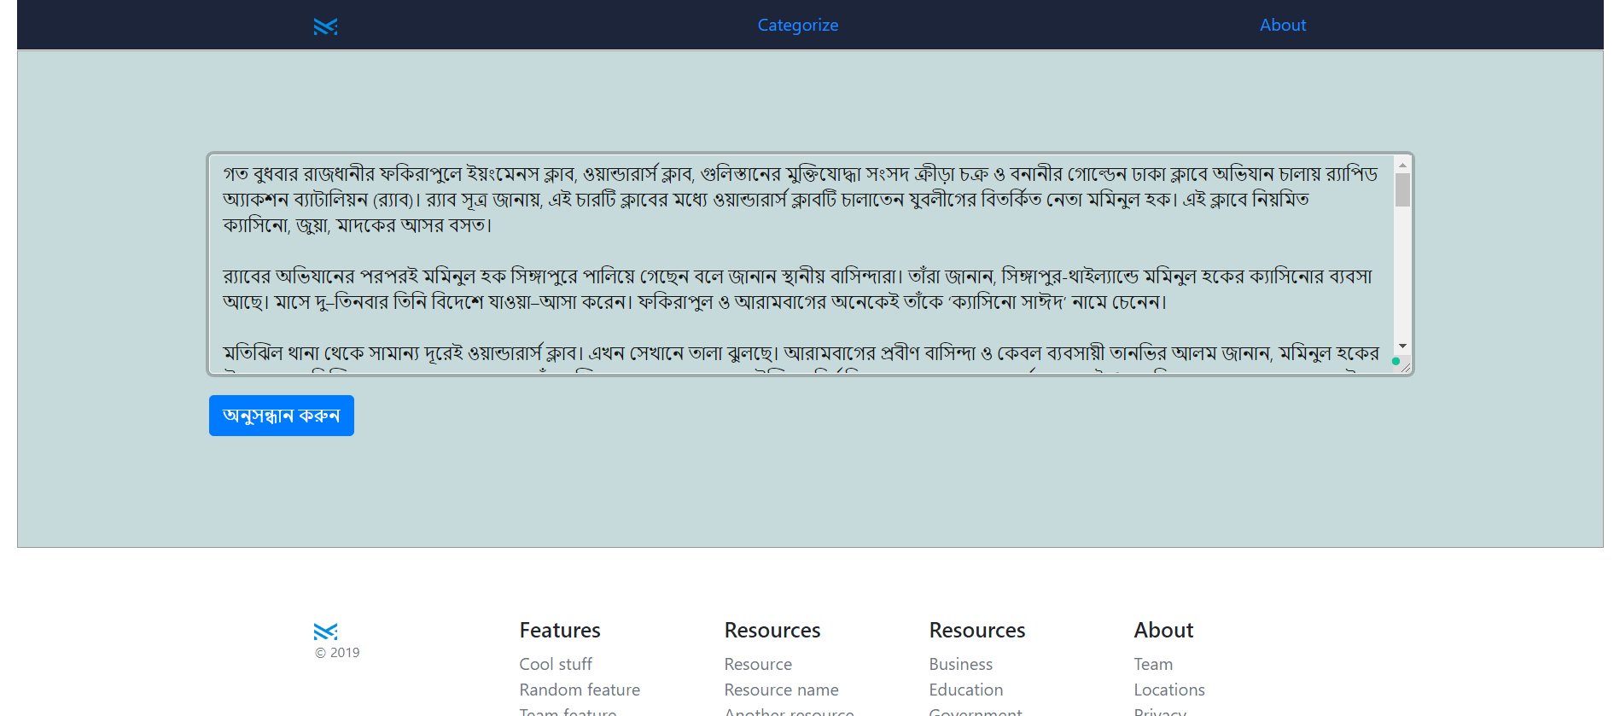
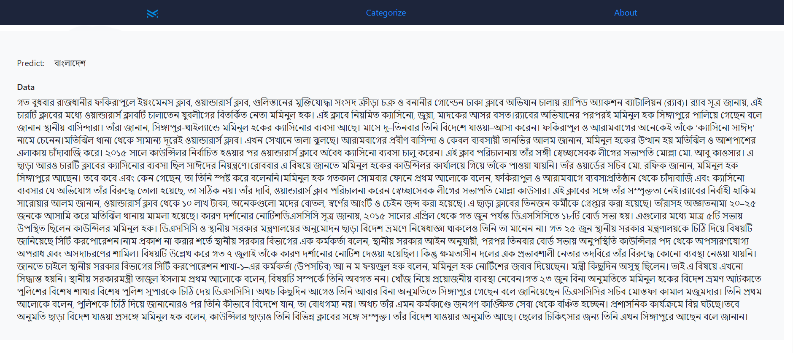
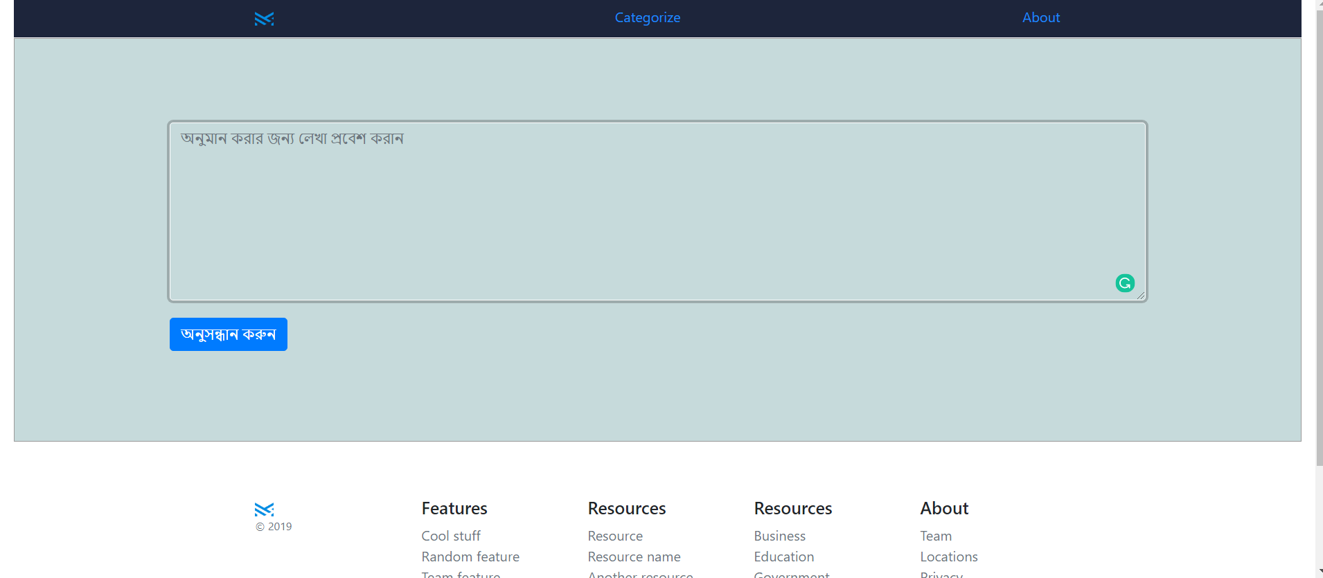
Web tool:
Bangla Text Categorization using ML
Dept. of CSE, UIU

Slide 18






Impacts
Constraints
Scarcity of Bangla text
Less research materials
Less implementation of research materials
Bangla Text Categorization using ML
Dept. of CSE, UIU

Slide 19
Standards
Code | Winconsin Standards [data analysis] PEP-8 [Python, Django]
License | GNU Coding Standards
Ethics | AIAS XIAs
UI UX | Material Design by Google
Bangla Text Categorization using ML
Dept. of CSE, UIU

Slide 20
THANK YOU
Bangla Text Categorization using ML
Dept. of CSE, UIU

